Slide 1

Clocks

Slide 2
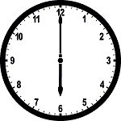
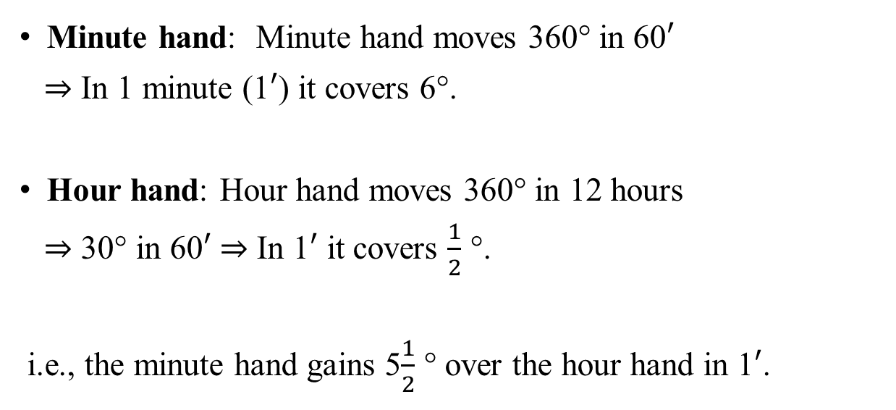
Relative Speed
Minute hand: Minute hand moves 360° in 60$′$
⇒ In 1 minute (1$′$) it covers 6°.
Hour hand: Hour hand moves 360° in 12 hours
⇒ 30° in 60$′$ ⇒ In 1$′$ it covers $\frac{1}{2}$ °.
i.e., the minute hand gains 5$\frac{1}{2}$ ° over the hour hand in 1$′$.

Slide 3
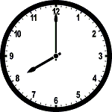
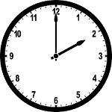
Example 1
An accurate clock shows 8 O'clock in the morning. Through how many degrees will the hour hand rotate when the clock shows 2 O'clock in the afternoon?
From 8 am to 2 pm the duration is 6 hours & angle traced by the hour hand in 6 hours is 6×30° = 180°.

Slide 4
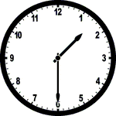
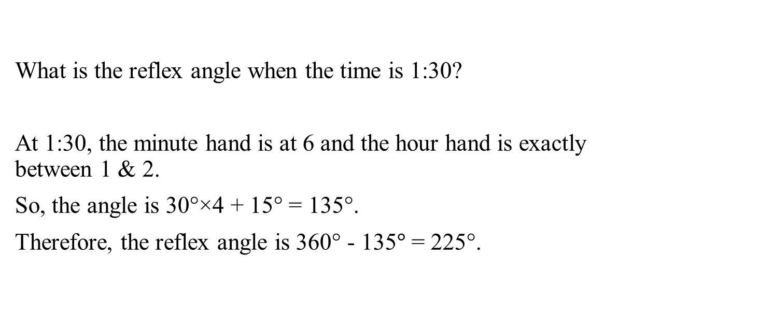
Example 2
What is the reflex angle when the time is 1:30?
At 1:30, the minute hand is at 6 and the hour hand is exactly between 1 & 2.
So, the angle is 30°×4 + 15° = 135°.
Therefore, the reflex angle is 360° - 135$°$ = 225°.

Slide 5

Quiz 1
How many degrees does an hour hand move in 54 minutes?
a. 304˚ b. 108˚ c. 27˚ d. 54˚
How many degrees does the minute hand move at the same time in which an hour moves by 18˚?
a. 108˚ b. 9˚ c. 256˚ d. 216˚
Find the angle when the time is 3:15?
a. 0˚ b. 7.5˚ c. 9˚ d. 0.5˚

Slide 6
Facts about clocks
In 12 hours
Hands coincides (0°) each other – 11 times
Hands opposite (180°) to each other – 11 times
Any other angle (90°, 60° etc.) – 22 times

Slide 7
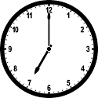
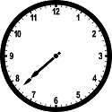

Example 3
At what time between 7 O’ clock and 8 O’ clock does the hands of the clock coincide?
At 7 O’clock, the minute hand is 210° behind the hour hand.
Time = $\frac{Distance}{R. Speed}$.
$$Req. Time=\frac{210°}{5\frac{1}{2} °}=\frac{420°}{11}= 38\frac{ 2 ′}{11}past 7 O’ clock.$$

Slide 8
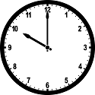
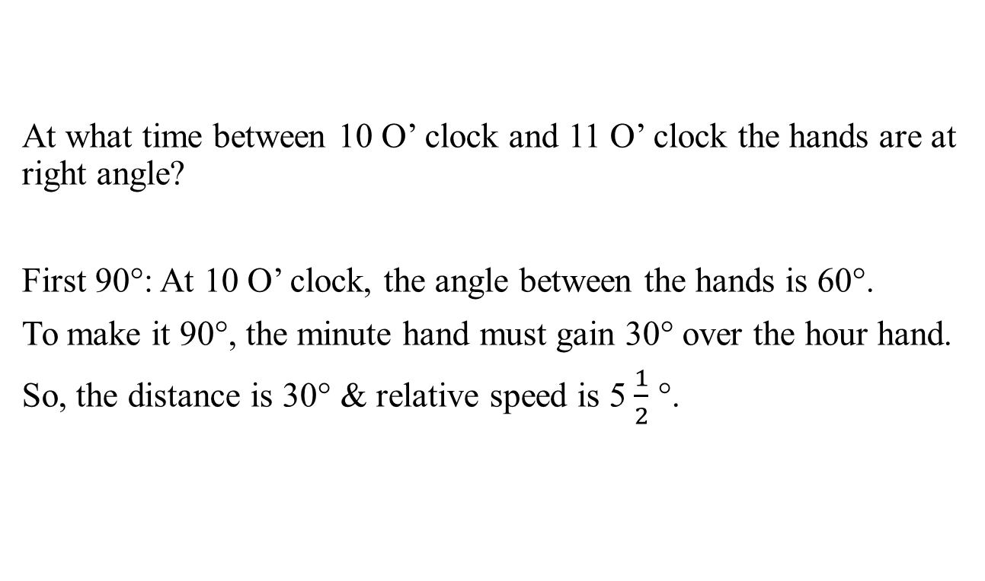
Example 4
At what time between 10 O’ clock and 11 O’ clock the hands are at right angle?
First 90°: At 10 O’ clock, the angle between the hands is 60°.
To make it 90°, the minute hand must gain 30° over the hour hand.
So, the distance is 30° & relative speed is 5$\frac{1}{2}$ °.

Slide 9
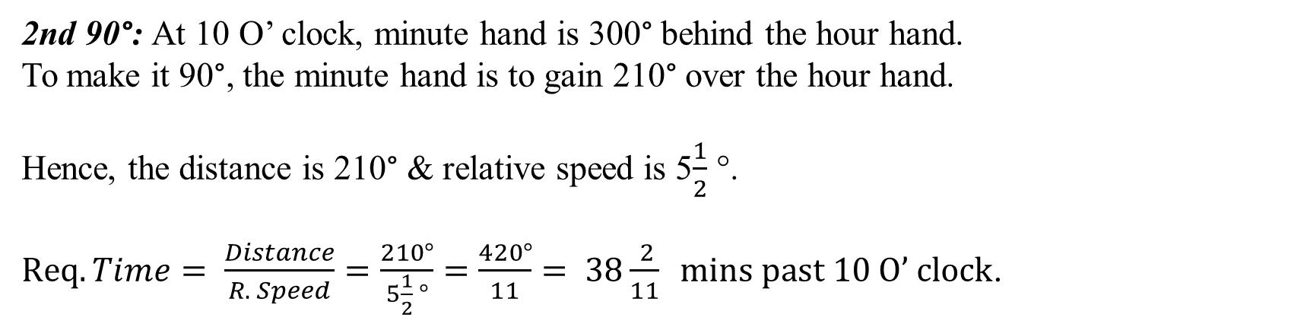
Example 4 cont.
$Req. Time= \frac{Distance}{R. Speed}= \frac{30°}{5\frac{1}{2} °}=\frac{60°}{11}= 5\frac{5}{11} mins past 10 O’ clock$.
2nd 90°: At 10 O’ clock, minute hand is 300° behind the hour hand.
To make it 90°, the minute hand is to gain 210° over the hour hand.
Hence, the distance is 210° & relative speed is 5$\frac{1}{2}$ °.
$Req.Time= \frac{Distance}{R. Speed}=\frac{210°}{5\frac{1}{2} °}=\frac{420°}{11}= 38\frac{ 2}{11} mins past 10 O’ clock$.

Slide 10

Formula
To calculate the angle between the hands of a clock,
$$θ= \frac{11}{2}m−30 h, when \left(\frac{11}{2}m>30 h \right)$$
$$or$$
$$θ=30 h− \frac{11}{2}m, when (30h>\frac{11}{2}m )$$
where m, minutes and h, hours.

Slide 11
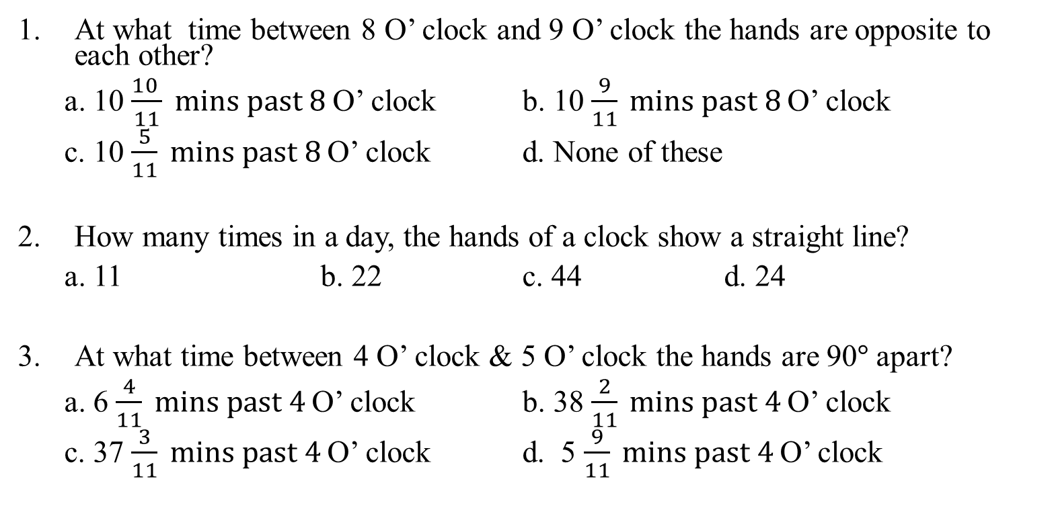
Quiz 2
At what time between 8 O’ clock and 9 O’ clock the hands are opposite to each other?
a. 10 $\frac{10 }{11} mins past 8$O’ clock b. 10 $\frac{9}{11} mins past 8$O’ clock
c. 10 $\frac{5}{11} mins past 8$O’ clock d. None of these
How many times in a day, the hands of a clock show a straight line?
a. 11 b. 22 c. 44 d. 24
At what time between 4 O’ clock & 5 O’ clock the hands are 90$°$ apart?
a. 6 $\frac{4}{11} mins past 4$O’ clock b. 38 $\frac{2}{11} mins past 4$O’ clock
c. 37 $\frac{3}{11} mins past 4$O’ clock d. 5 $\frac{9}{11} mins past 4$O’ clock

Slide 12

Too fast / Too slow
Time taken by the minute hand to overtake the hour hand is
$\frac{Distance}{R. Speed}= \frac{360°}{5\frac{1}{2} °}=65 \frac{5}{11}′$.
i.e. in an accurate clock, the minute hand will overtake the hour hand after every $65 \frac{5}{11}′$.
If it takes more than $65 \frac{5}{11}′$, then the clock is said to be too slow
If it takes less than $65 \frac{5}{11}′$, then the clock is said to be too fast.

Slide 13

Example 5
How much does a watch gain per day, if its hands coincide every 64$′$?
In an accurate clock, the minute hand overtakes the hour hand after every $65 \frac{5}{11} ′$.
But here it happens after every 64$′$.
Therefore, the gain is 1 $\frac{5}{11}′$ for every 64$′$.
⇒ in 1 minute, it gains $\frac{16}{11} ×\frac{1}{64}$ $′$
⇒ in 1 hour, it gains $\frac{16}{11}×\frac{60}{64}′$
⇒ in a day it gains $\frac{16}{11}×\frac{60}{64}×24= 32\frac{8}{11}$ $′$.

Slide 14
Example 6
A watch which loses uniformly was observed to be 10 min fast at 6 am on 1st of a month. It showed 20 min less than the correct time at 6 pm on the 3rd of the same month. When did the watch show the correct time?
From 6 am 1st to 6 pm 3rd, time difference is 60 hours.
⇒ 30 minutes loss in 60 hours
⇒ 1-minute loss in 2 hours
⇒ 10 minutes loss in 20 hours
Therefore, next correct time is 20 hours from 6 am on 1st.
i.e., on 2nd 2 am.

Slide 15
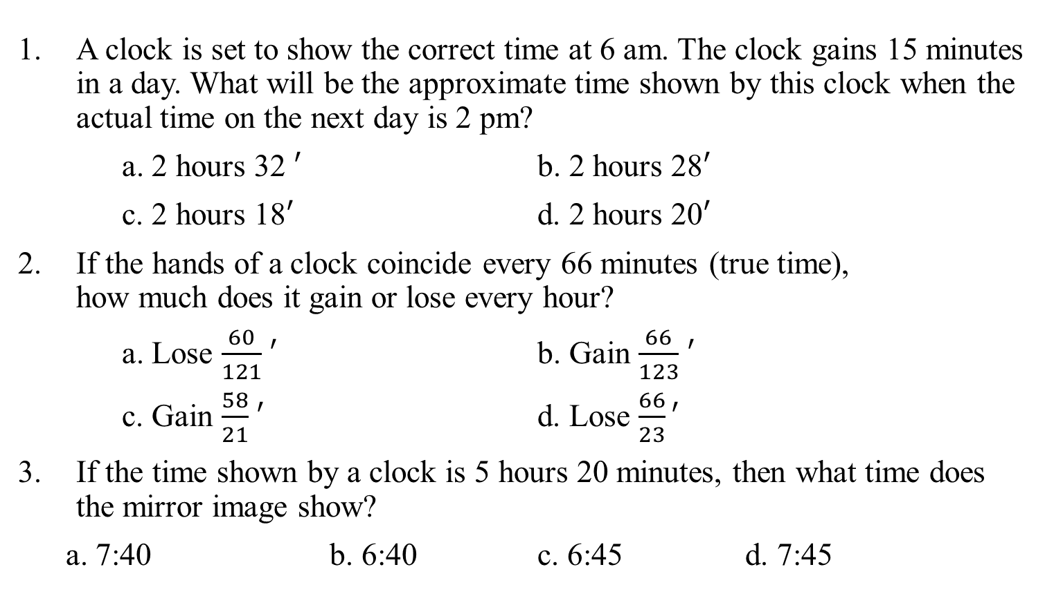
Quiz 3
A clock is set to show the correct time at 6 am. The clock gains 15 minutes in a day. What will be the approximate time shown by this clock when the actual time on the next day is 2 pm?
a. 2 hours 32 $′$ b. 2 hours 28$′$
c. 2 hours 18$′$ d. 2 hours 20$′$
If the hands of a clock coincide every 66 minutes (true time), how much does it gain or lose every hour?
a. Lose $\frac{60}{121}$ $′$ b. Gain $\frac{66}{123}$ $′$
c. Gain $\frac{58}{21}$ $′$ d. Lose $\frac{66}{23}′$
If the time shown by a clock is 5 hours 20 minutes, then what time does the mirror image show?
a. 7:40 b. 6:40 c. 6:45 d. 7:45

Slide 16

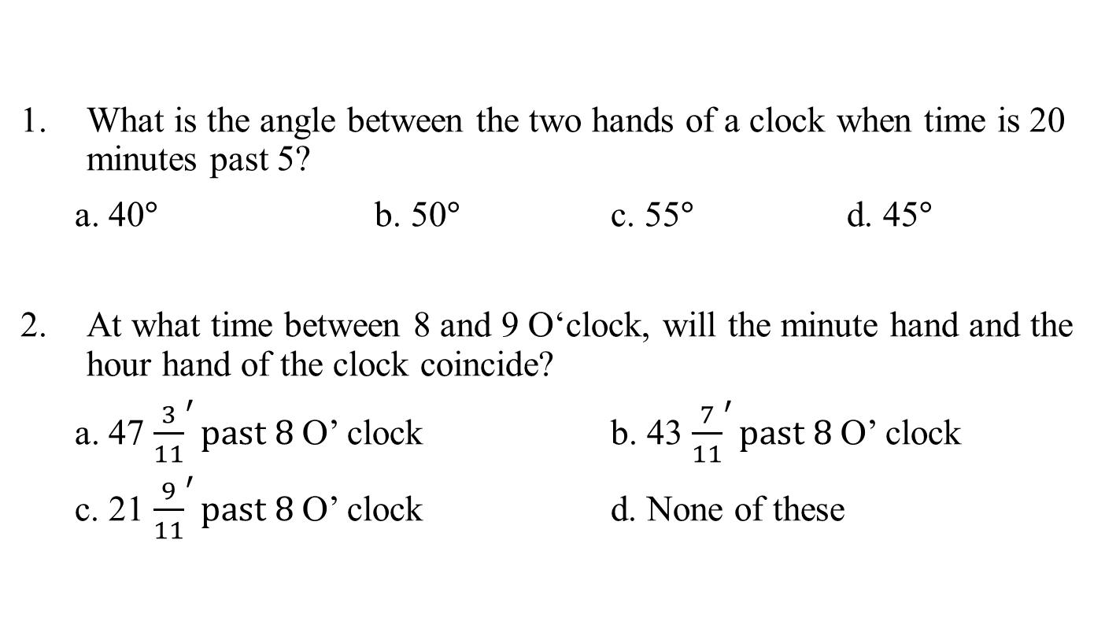
Assignment
What is the angle between the two hands of a clock when time is 20 minutes past 5?
a. 40$°$ b. 50$°$ c. 55$°$ d. 45$°$
At what time between 8 and 9 O‘clock, will the minute hand and the hour hand of the clock coincide?
a. 47 ${\frac{3}{11}}^{′}past 8$O’ clock b. 43 ${\frac{7}{11}}^{′}past 8$O’ clock
c. 21 ${\frac{9}{11}}^{′}past 8$O’ clock d. None of these

Slide 17

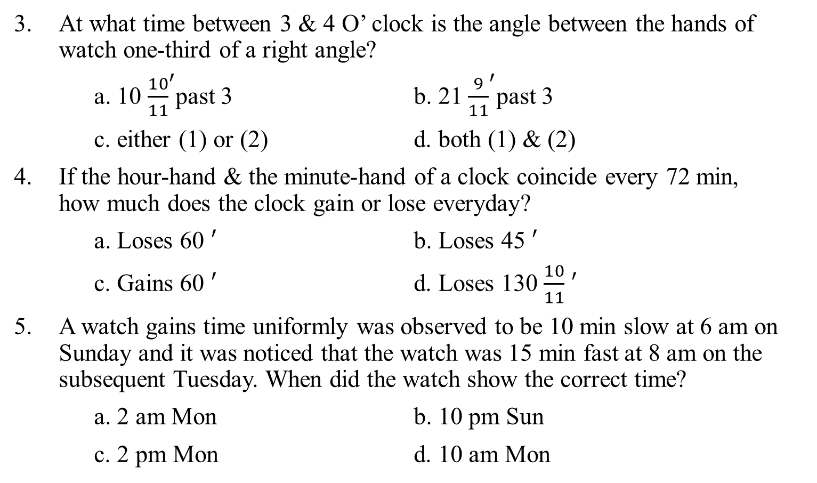
Assignment
At what time between 3 & 4 O’ clock is the angle between the hands of watch one-third of a right angle?
a. 10 ${\frac{10}{11}}^{′}$past 3 b. 21${ \frac{9}{11}}^{′}$past 3
c. either (1) or (2) d. both (1) & (2)
If the hour-hand & the minute-hand of a clock coincide every 72 min, how much does the clock gain or lose everyday?
a. Loses 60 $′$ b. Loses 45 $′$
c. Gains 60 $′$ d. Loses 130 $\frac{10}{11}$ $′$
A watch gains time uniformly was observed to be 10 min slow at 6 am on Sunday and it was noticed that the watch was 15 min fast at 8 am on the subsequent Tuesday. When did the watch show the correct time?
a. 2 am Mon b. 10 pm Sun
c. 2 pm Mon d. 10 am Mon

Slide 18
Assignment
A clock gains 2 minutes in an hour and another clock loses 4 minutes in an hour. If both these clocks were set at 8 a.m., what will be the time in the first clock, if the second clock shows 10 p.m.?
a. 8:30 p.m. b. 9:30 p.m. c. 11:20 p.m. d. 11:30 p.m.
In a clock at 7 hours 45 min if the hour hand is pointing towards North, then towards which direction does the minute hand point at 10 O’ clock?
a. East b. West c. North-East d. North-West
The pendulum of a clock takes 6 seconds to strike 4 o’clock. How much time will it take to strike 11 o’clock?
a. 25 sec b. 20 sec c. 18 sec d. 16.5 sec

Slide 19
Assignment
9. A clock is set right at 8 am and it gains 10 minutes in 24 hours. What will be the true time when the clock indicates 1 pm on the following day?
a. 12 O' clock b. 16 ′past 12 O' clock
c. 48 ′ past 12 O' clock d. 30 ′past 12 O' clock
10. The mirror reflection of a clock shows 3.30 hrs. After two hours, what time the mirror reflection of the clock will show?
a. 8.30 b. 5.30
c. 2.30 d. 1.30

Slide 20
Puzzles
At what time between 4 & 5 O’clock the two hands are equidistant from 5?
A clock loses 5 seconds an hour and is set right on Sunday at noon, when will it next show the correct time?
A clock is set right at 5 am and it loses 16 min in 24 hours. What will be the right time when the clock indicates 10 pm on the 4th day?
The minute hand of a clock is 10 cm long, while the hour hand is 9 cm long. From 12 noon what will be the difference in area covered by the two hands in 21 minutes?

Slide 21
Puzzles
A man, who went out between 5 and 6 O’ clock and returned between 6 and 7 O’ clock, found that the hands of the watch had exchanged places.
When did he go out?
How long he was away.
When did he come back.
What is the angle between the hands.
*******

Slide 22
Thank You
Narayan

